Slide 1

Retail Sales Analysis

Slide 2

AGENDA
Project rEcap
Process
visualisations and Insights
RECOMMENDATIONS

Slide 3
PROJECT RECAP
An online retail store has been growing steadily, but the leadership team wants a deeper understanding of the factors driving revenue to make strategic plans for the upcoming year.
They are looking for clear, actionable insights that highlight strengths, identify opportunities , and ultimately guide expansion efforts.
Key objectives:
Identify Revenue Drivers: Highlight top factors contributing to revenue growth.
Assess Marketing and Operations: Analyse key perfomances metrics to pinpoint successes and improvement areas.
Deliver Demographic Insights: Provide targeted insights by demographic segments, including location, to reveal trends.
Guide expansion Strategy: Recommend high-performing areas for potential expansion and strategic planning.

Slide 4



Process
1. Data understanding
2. Data cleaning and Preparation
3. Data Exploration and Modelling
4. TARGETED ANALYSIS
5. VISUALISATIONS AND INSIGHTS

Slide 5

Visualisations and Insights

Slide 6
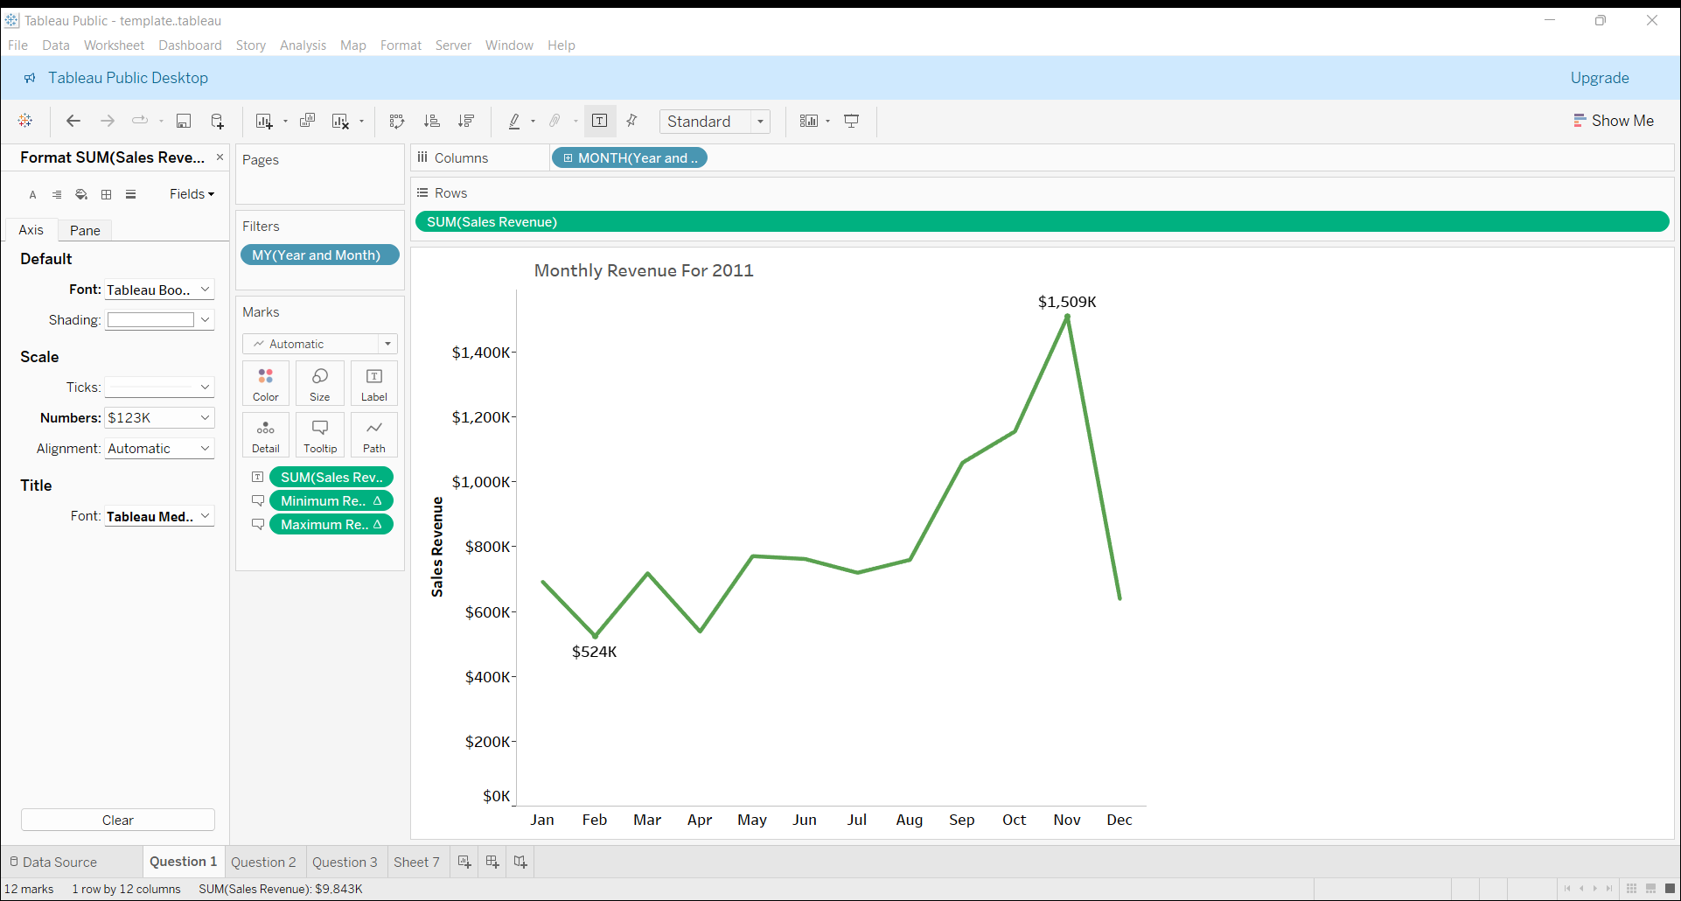
MONTHLY REVENUE FOR 2011
INSIGHTS
This time series line chart shows seasonal
trends in revenue for 2011, with noticeable
peaks around November and December, likely
due to holiday shopping.
This trend can be used to plan inventory and
marketing efforts for peak months, such as holiday
season.

Slide 7
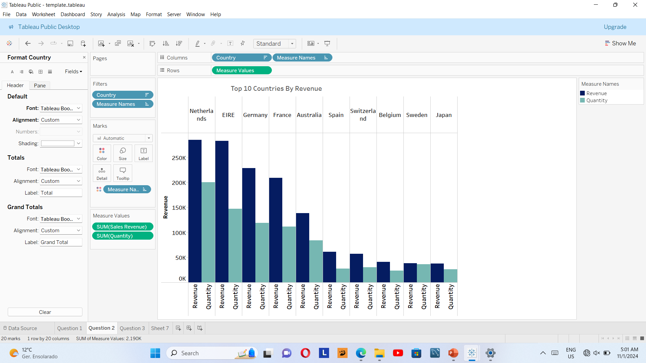
TOP 10 COUNTRIES BY REVENUE
INSIGHTS
The chart highlights the highest revenue-
generating countries outside the UK, led by
the Netherlands and EIRE.
Both revenue and quantity are shown, which can
help understand if high revenue is driven by high
prices or large volumes.
Countries with both high revenue and quantity(like
the Netherlands and Germany) may be strong
canditates for expansion and targeted marketing
strategies.

Slide 8
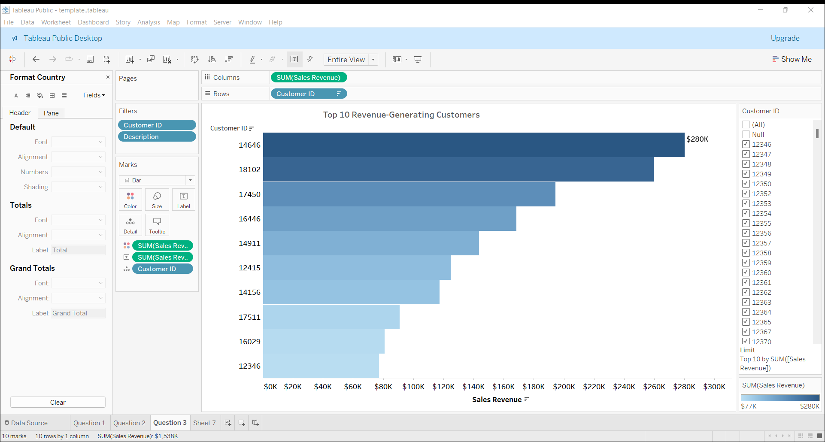
TOP 10 CUSTOMERS BY REVENUE
INSIGHTS
The bar chart ranks customers by
revenue contribution, which will
help in targeting high-value
customers for retention.
The top 10 customers drive a
significant share of revenue, with the
highest reaching $280K+.
Maintaining relationships with these
top customers could be crucial for
sustained revenue, as they contribute
significantly to sales.

Slide 9
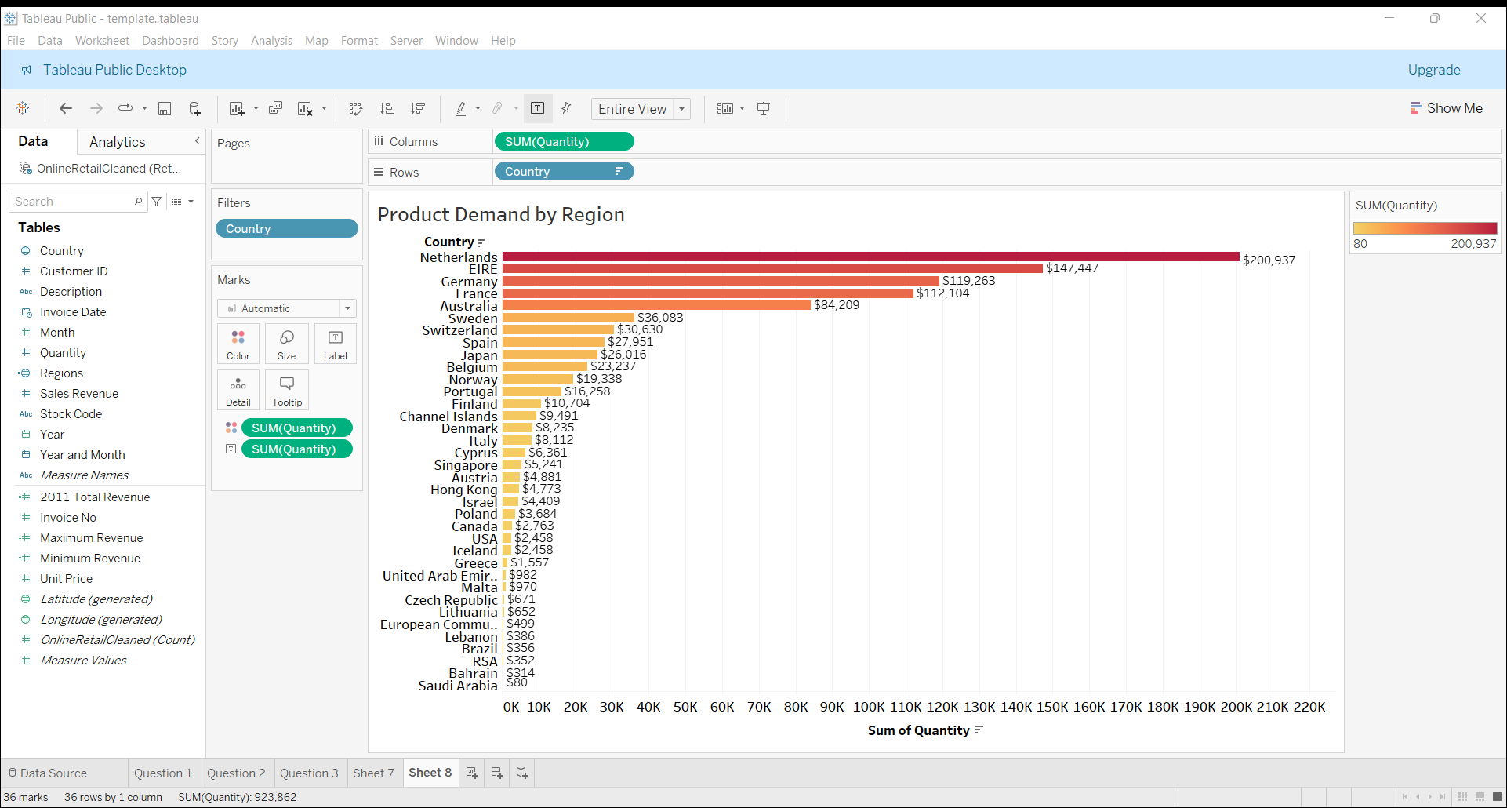
PRODUCT DEMAND BY REGION
INSIGHTS
This bar chart displays demand
across various countries excluding the UK.
The Netherlands shows the highest-
demand among countries, making it a
strategic focal point for expansion
and product offerings.
EIRE, Germany and France also
demonstrate strong demand, indicating
potential for impactful marketing and
sales effort in these areas.
Moderate-demand countries like
Switzerland, Spain and Japan may benefit
from targeted growth strategies.

Slide 10
STRATEGIC RECOMMENDATIONS
Seasonal Sales Strategy:
Increase stock levels and run targeted marketing campaigns in Q4 to leverage peak sales.
Offer discounts or promotions during lower sales months to balance demand across the year.
2. Market Expansion:
Prioritize expansions efforts in Netherlands, Ireland and Germany, which have the highest revenue potential, while exploring ways to increase sales volume in lower-perfoming countries.
Test product fit and gather insights in growing markets, such as Cyprus and Hong Kong , through small scale pilot initiatives.
Customer Retention:
Introduce loyalty programs and special offers for high-revenue customers.
Implement personalised marketing based on purchasing patterns to enhance customer satisfaction and retention.

Slide 11


Thank you! any questions?

